Slide 1

Tasky a task management app
Badr El-Said
Adham Anas
Nour Khaled
Ali el-deen maher
Mohamed Mostafa
Youssef awed

Slide 2
Plans are nothing; planning is everything
Dwight D. Eisenhower
Dwight D. Eisenhower

Slide 3
Introduction
In today's fast-paced world, individuals and teams struggle to stay organized and on top of their workloads, leading to missed deadlines, decreased productivity, and increased stress.
Using Tasky, you can regain control of your time and achieve your goals with ease
Tasky provides a user-friendly platform for organizing tasks, setting priorities, tracking progress, and collaborating with others.

Slide 4

objectives
An Application that help users:
Manage their time efficiently
Organize their tasks and categorize them into projects.
Set due dates for tasks with Notifications and reminders for upcoming due dates.
Filter tasks by priority, or due date.
Track their progress in completing their tasks.

Slide 5
Features
Tasky includes four main pages/Tabs:
The Task tab
Study techniques tab
Tasks progress tab
The Calendar

Slide 6
Task tab
The main page for the app

Slide 7
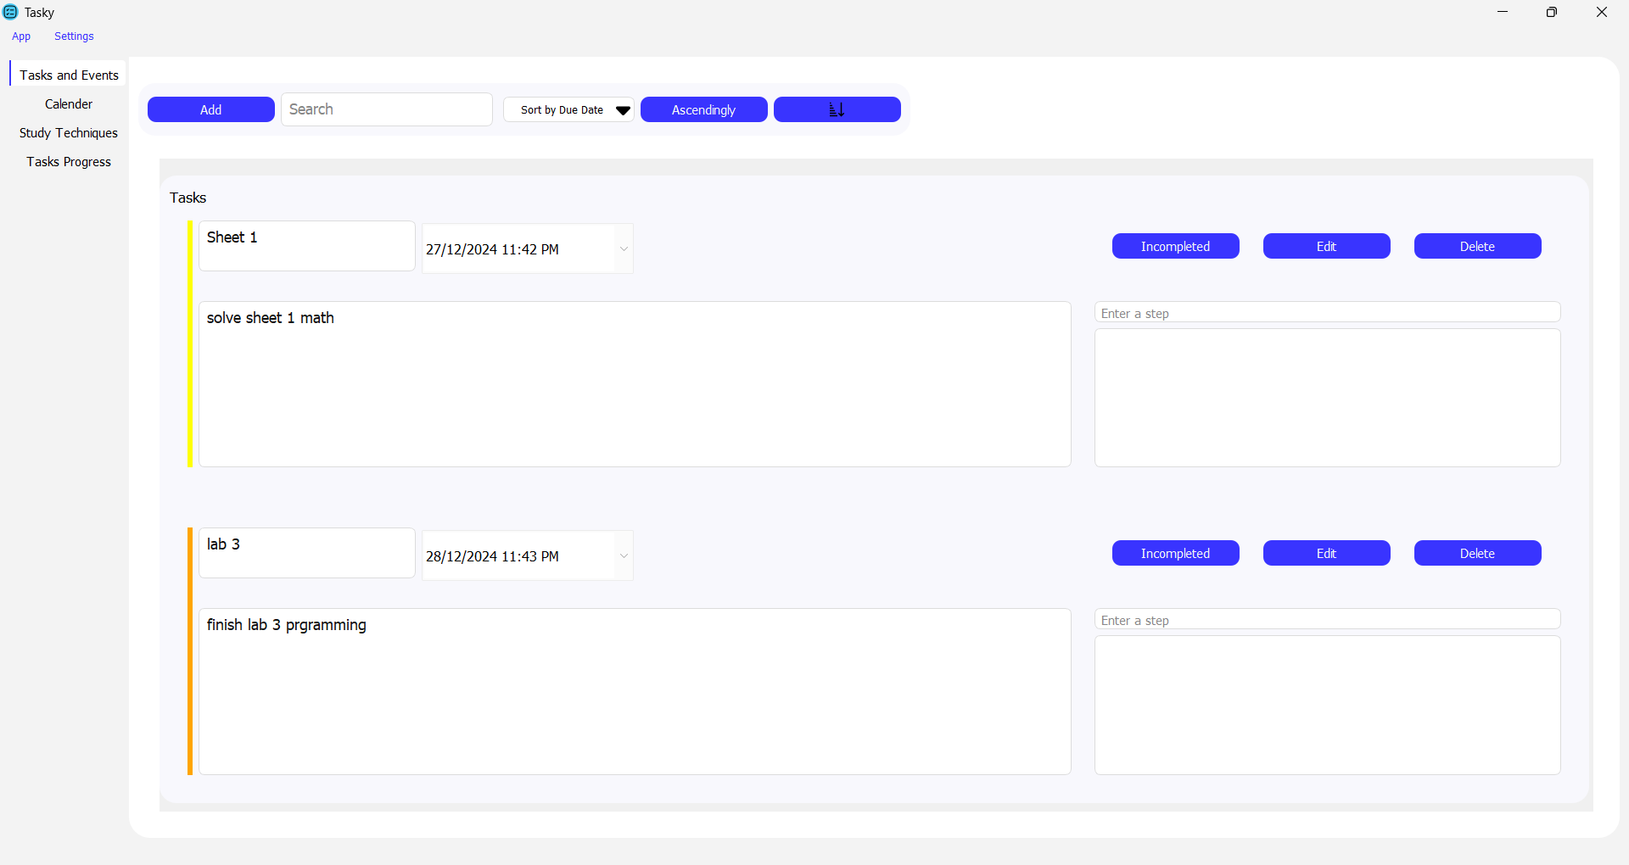
Task Tab
In the task tab we can create our tasks or events , search , sort , edit or delete existing tasks and mark tasks as completed if we finished them

Slide 8
Task Tab
By clicking on “Add” button , we can create our customized tasks

Slide 9
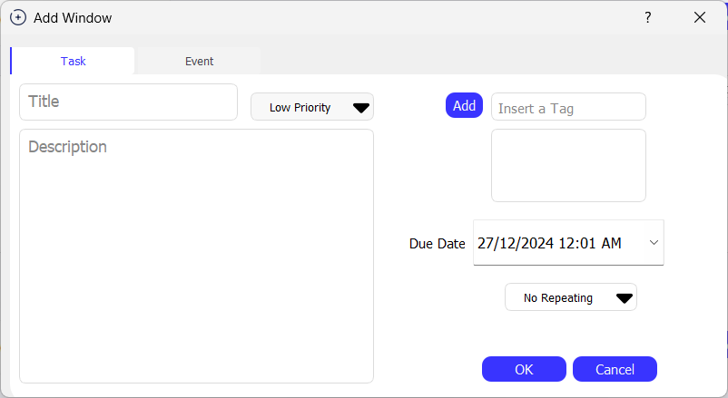
Task Tab
In the “Add Window” there are multiple fields to customize the task

Slide 10
Task Tab
Set the Task Title and Description

Slide 11
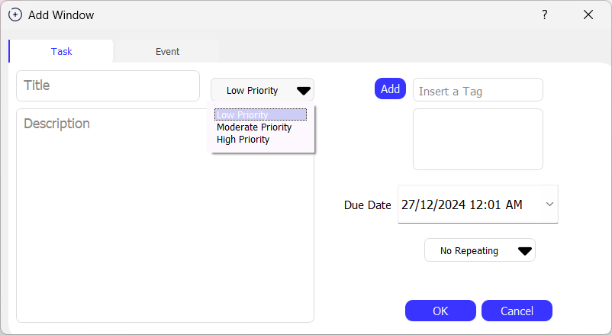
Task Tab
2. Set the task priority based on its importance for you

Slide 12
Task Tab
3. Choose a tag for your task to categorize it (optional)

Slide 13
Task Tab
4. Set the deadline/Due Date for the task

Slide 14
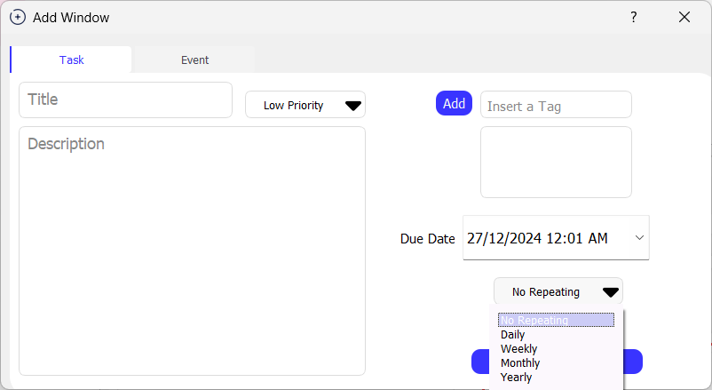
Task Tab
5. Choose the repeating manner of the task (None, daily, weekly, monthly, yearly)

Slide 15
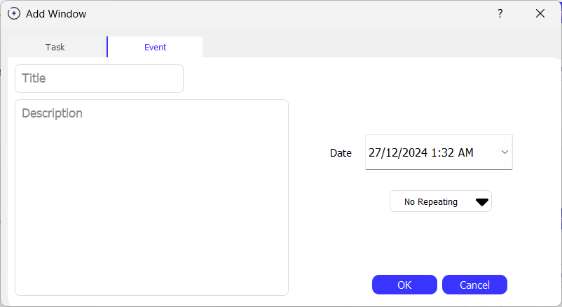
Task Tab
We can add also an event the same way as the task

Slide 16
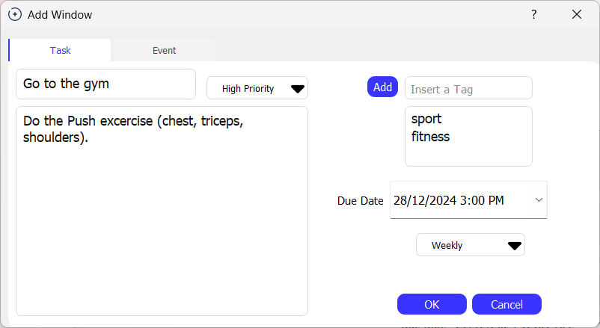
Task Tab
6. Example of creating a task

Slide 17
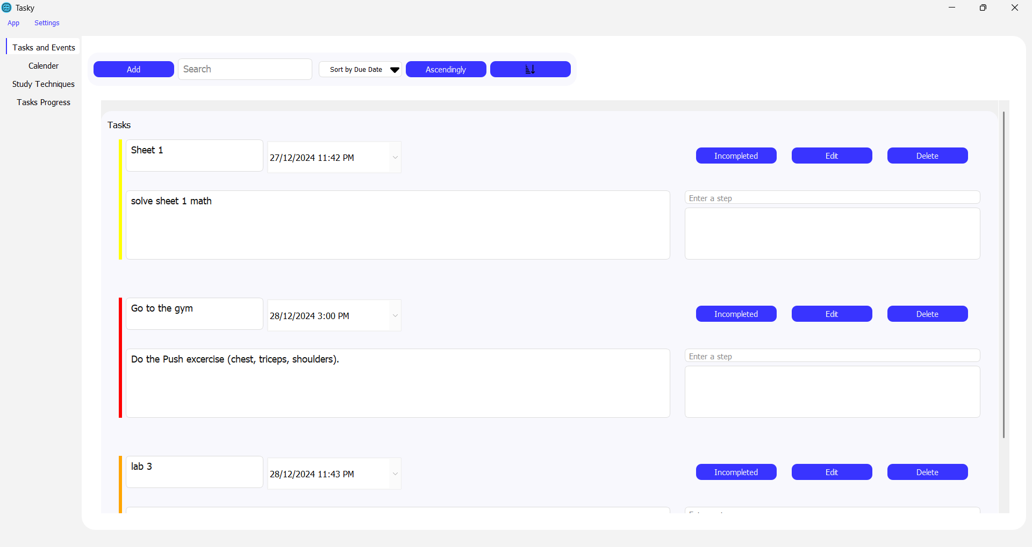
Task Tab
6. Example of creating a task

Slide 18
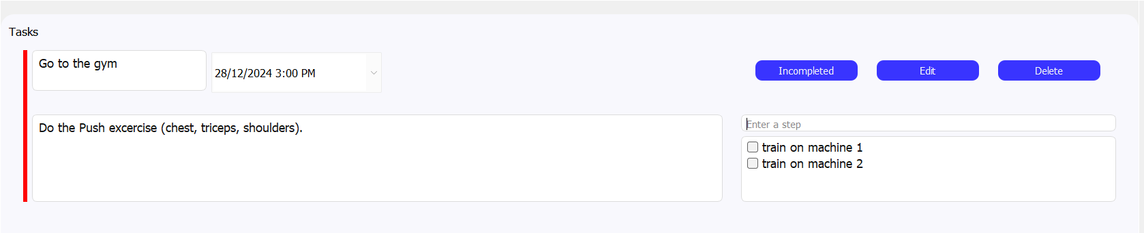
Task Tab
We can enter any number of subtasks for a single tasks

Slide 19
Task Tab
By clicking on “Edit” button , we can edit the current task

Slide 20
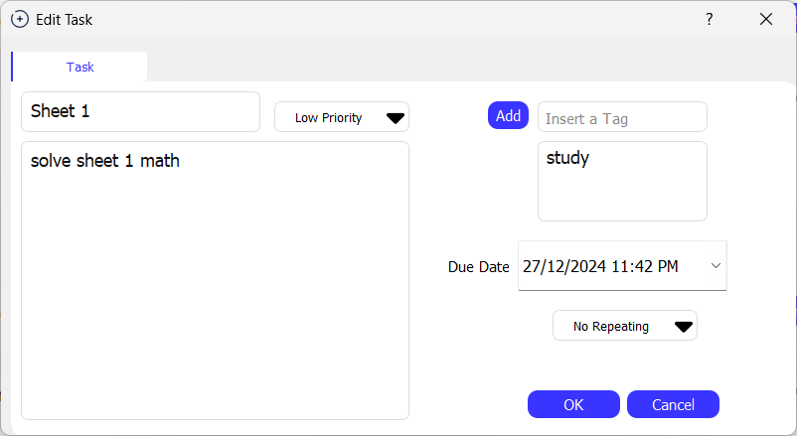
Task Tab
In the Edit Window , we can edit any field of the previous fields

Slide 21
Task Tab
By clicking on “delete” button, we can remove the task

Slide 22
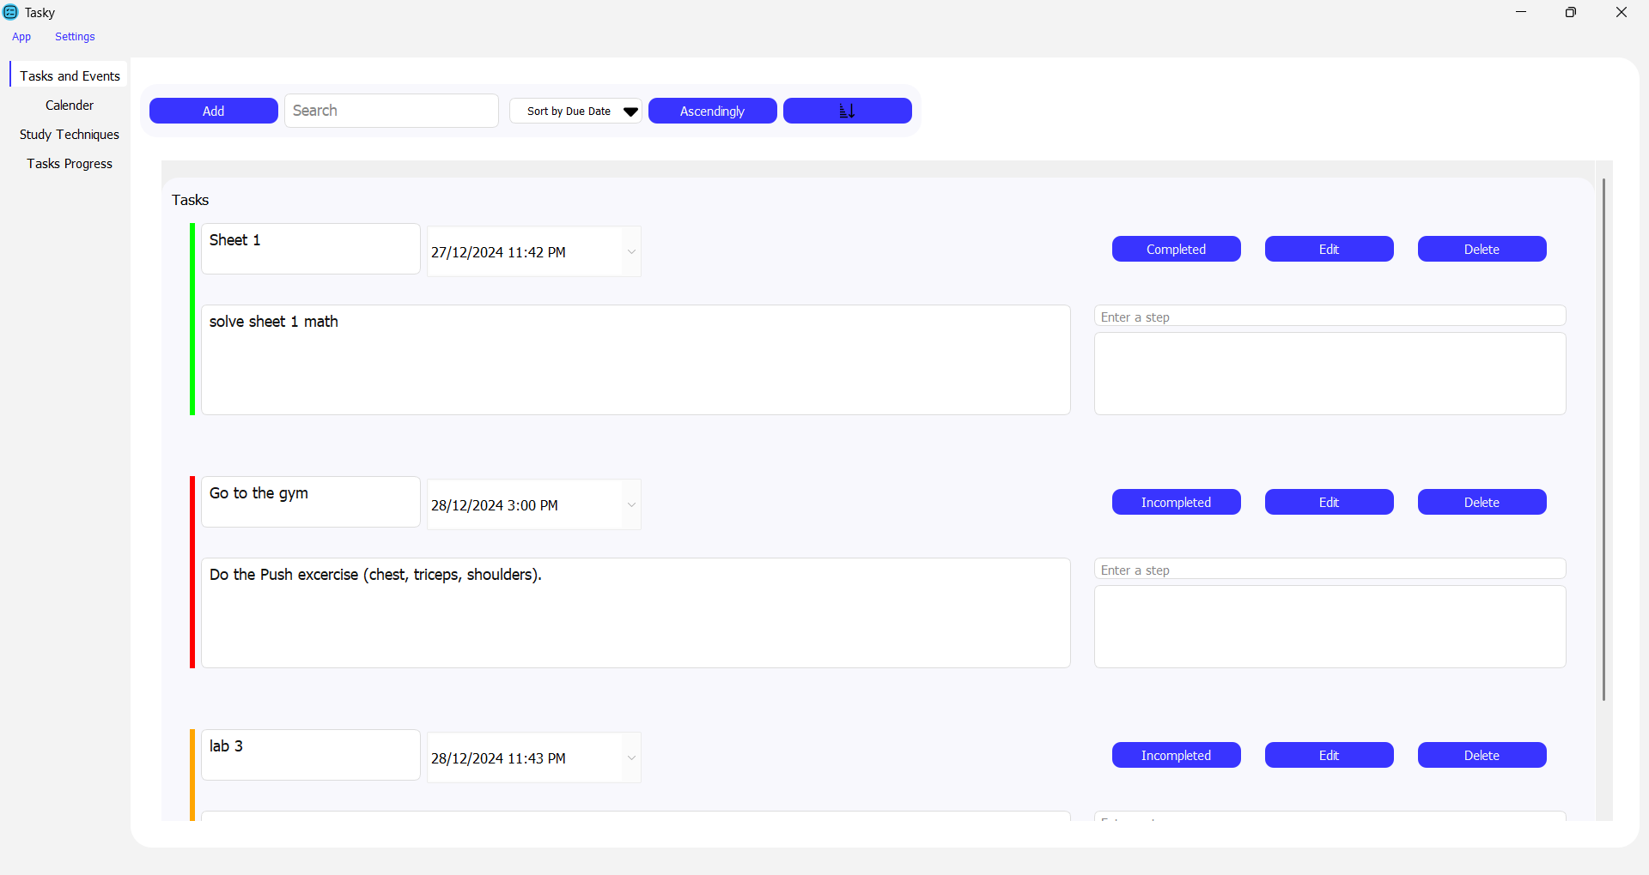
Task Tab
By clicking on “Incompleted” button, the task marked as completed and the task bar changes to green

Slide 23
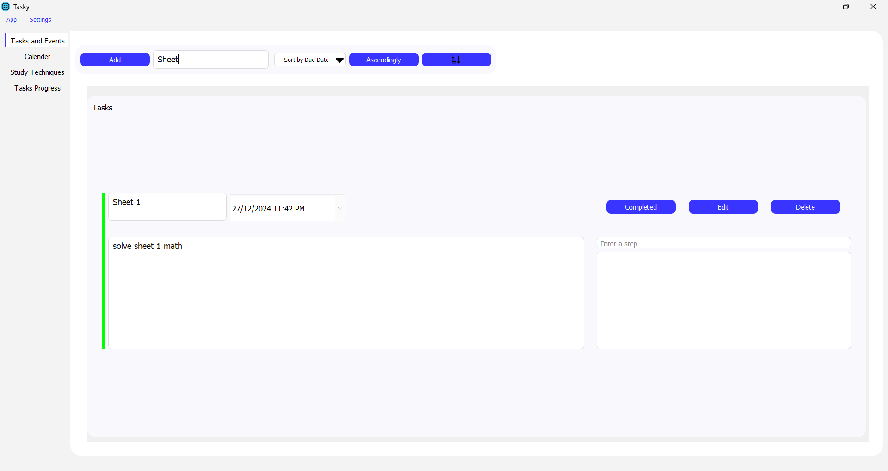
Task Tab
We can search for the task based on its title

Slide 24
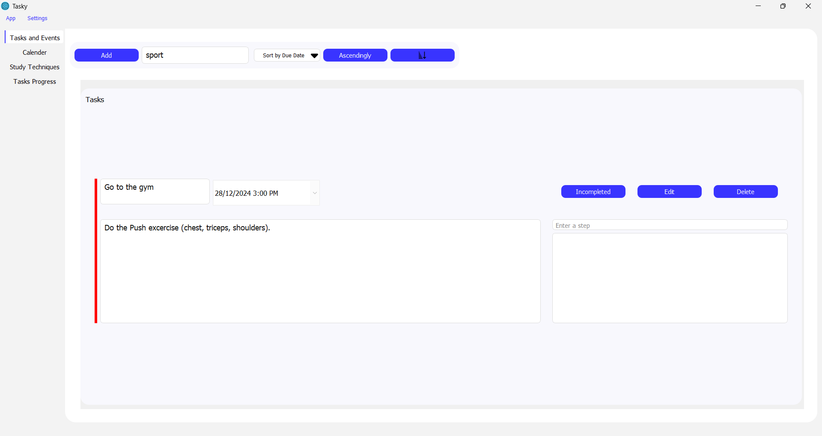
Task Tab
We can also search for the task based on its tag

Slide 25
Task Tab
We can sort the existing tasks based on the “Due Date” in both ascending and descending way

Slide 26
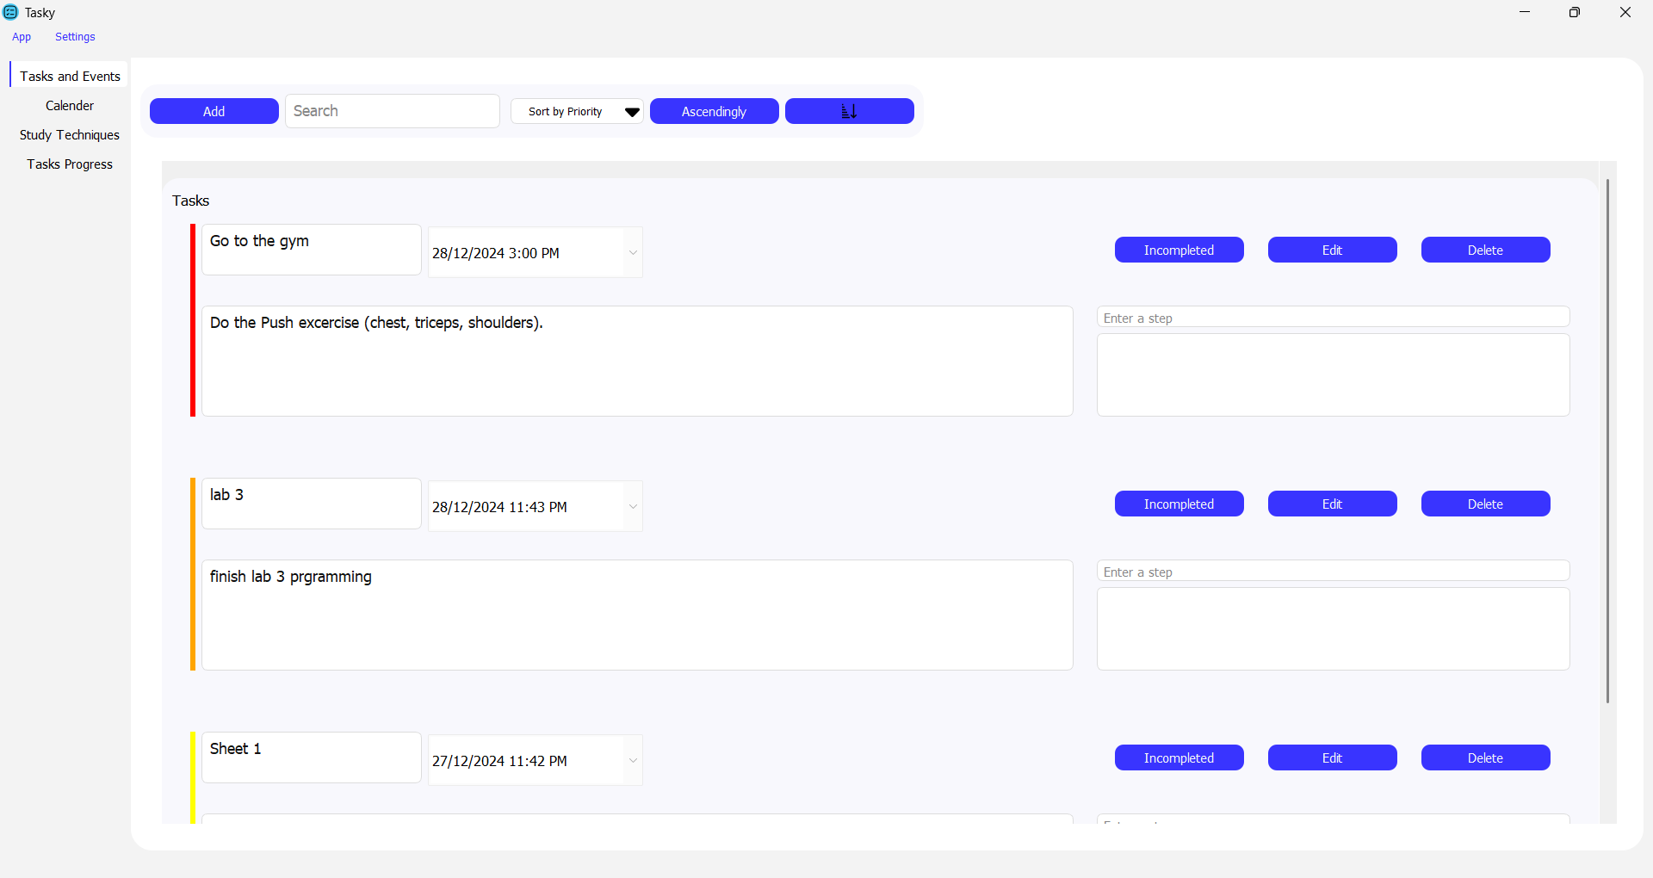
Task Tab
We can sort the existing tasks based on the “priority” in both ascending and descending way the colors indicates the priority (red for high priority, orange for moderate, yellow for low)

Slide 27
Calendar tab
Visualize tasks in the month

Slide 28
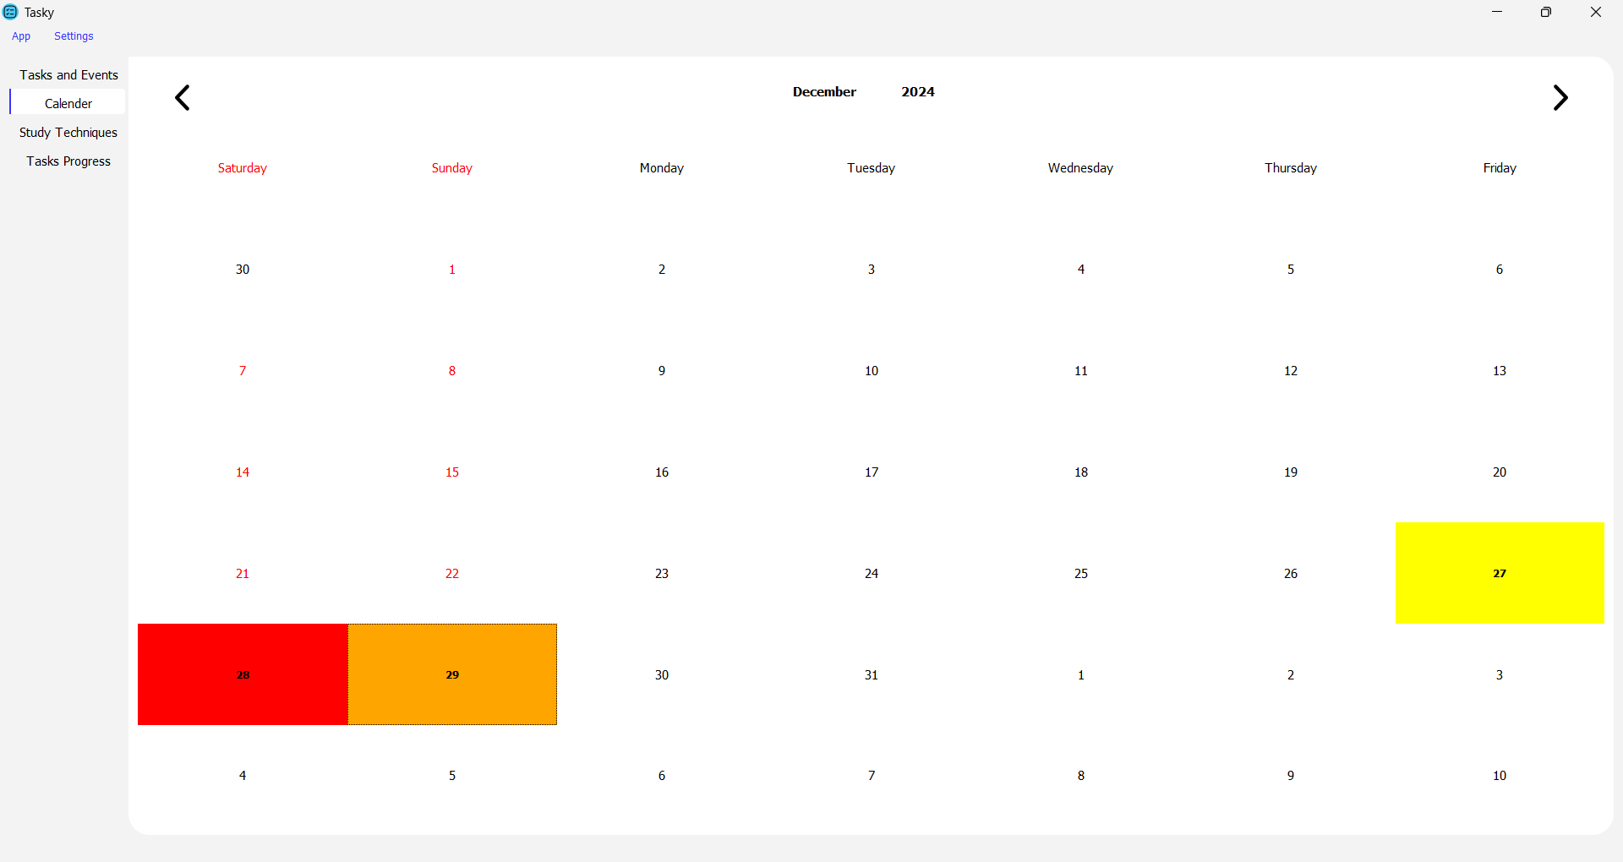
calendar Tab
In the calendar tab you can observe tasks/events in the calendar form

Slide 29
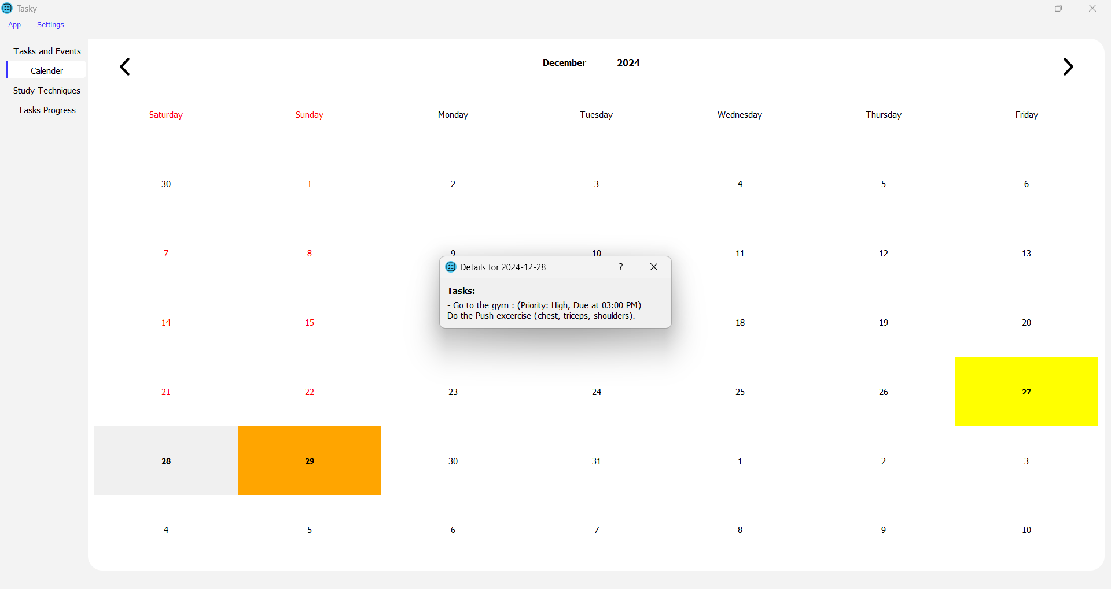
calendar Tab
By clicking on any day , we can display that day tasks

Slide 30
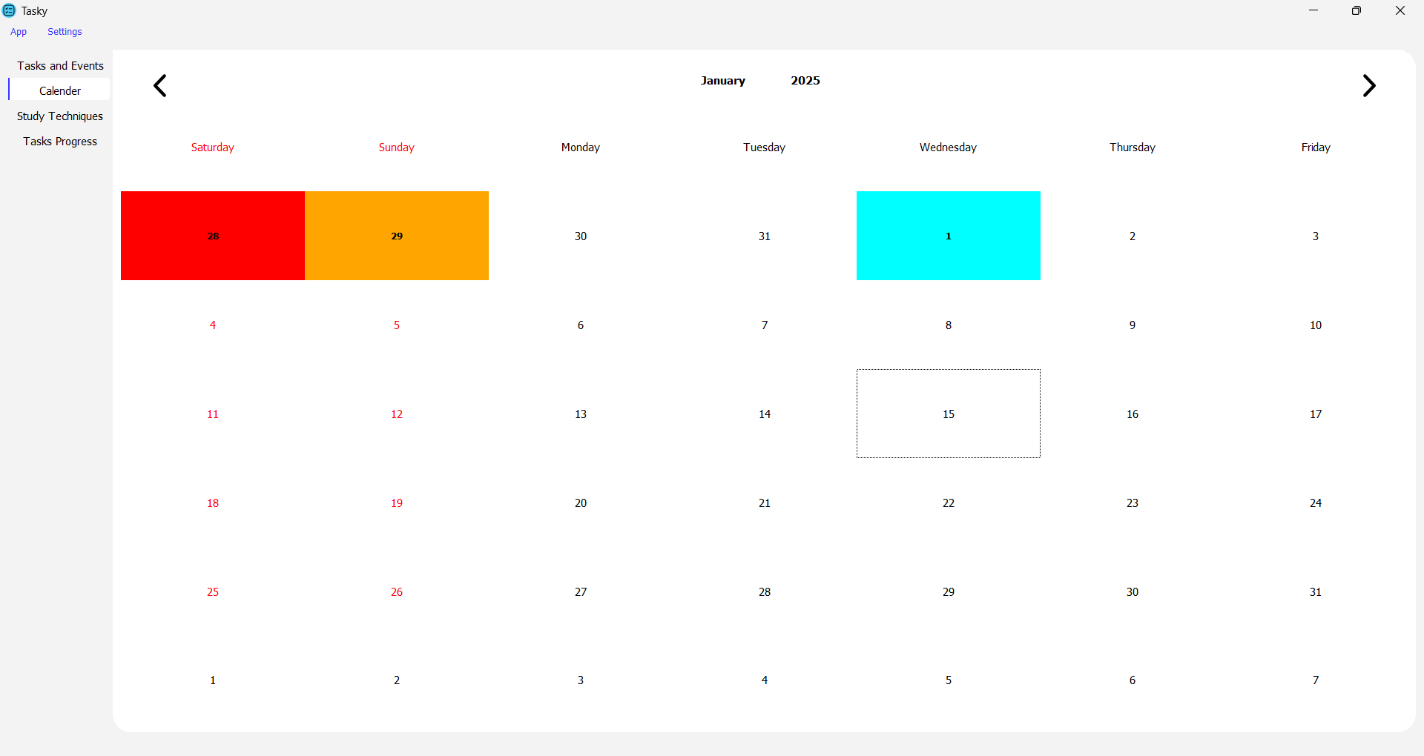
calendar Tab
Events are added directly and shown in the calendar tab for more simplicity with the light blue color

Slide 31
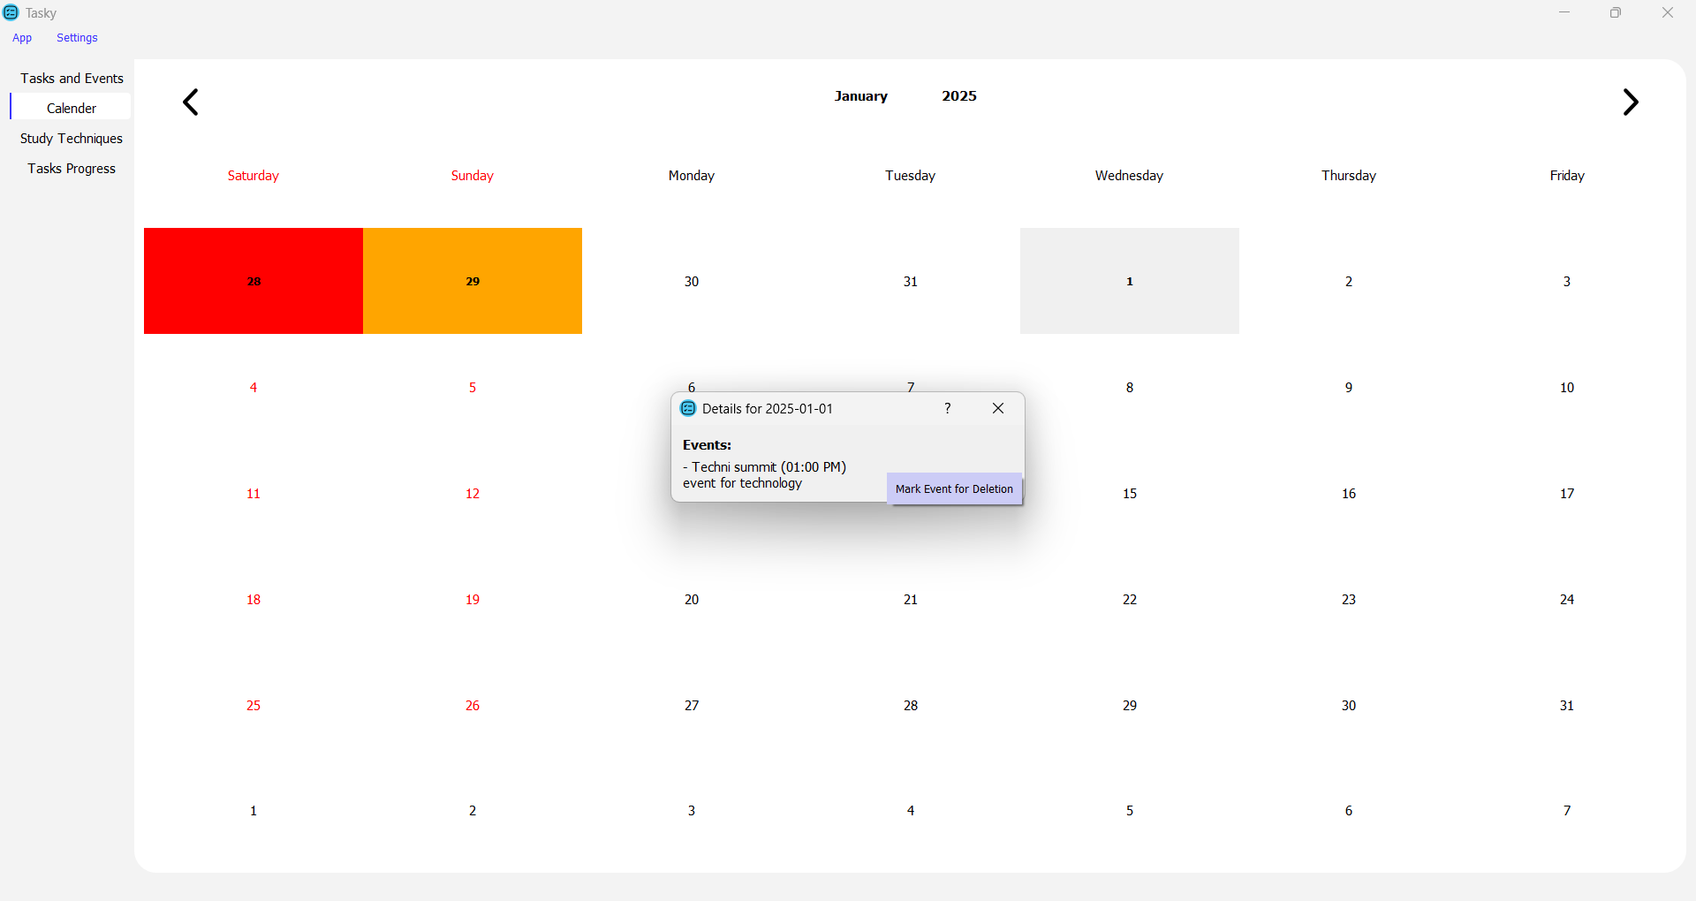
calendar Tab
We can delete events directly from the calendar

Slide 32
study techniques tab

Slide 33
task progress tab

Slide 34
Summary
With PowerPoint, you can create presentations and share your work with others, wherever they are. Type the text you want here to get started. You can also add images, art, and videos on this template. Save to OneDrive and access your presentations from your computer, tablet, or phone. ​

Slide 35

THANK YOU
PRESENTER NAME
EMAIL
WEBSITE

